Slide 1
Troubleshooting Virtual Networking
Module 4

Slide 2
Importance
Networks are used to access or control nearly every component in the VMware vSphere® environment. When a network problem occurs, you must quickly diagnose and resolve it to minimize the negative user impact.

Slide 3
You Are Here
Course Introduction
Introduction to Troubleshooting
Troubleshooting Tools
Troubleshooting Virtual Networking
Troubleshooting Storage
Troubleshooting vSphere Clusters
Troubleshooting vCenter Server and ESXi
Troubleshooting Virtual Machines

Slide 4
Learner Objectives
By the end of this module, you should be able to meet the following objectives:
Provide a network troubleshooting overview
Analyze and troubleshoot standard switch problems
Analyze and troubleshoot virtual machine connectivity problems
Analyze and troubleshoot management network problems
Analyze and troubleshoot distributed switch problems

Slide 5
Networking Troubleshooting Overview
In vSphere, networking problems can occur with the following types of connectivity:
Virtual switch connectivity:
Standard switches
Distributed switches
Virtual machine network connectivity
VMware ESXiTM host management network connectivity
A vSphere administrator should know how to troubleshoot common networking issues.

Slide 6
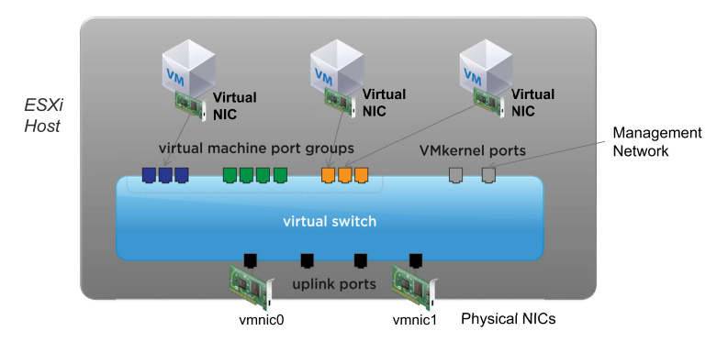
Review of Standard Switch
If a virtual machine loses network connectivity, the cause of the problem might be anywhere from the virtual machine’s NIC to the ESXi host’s physical network.

Slide 7
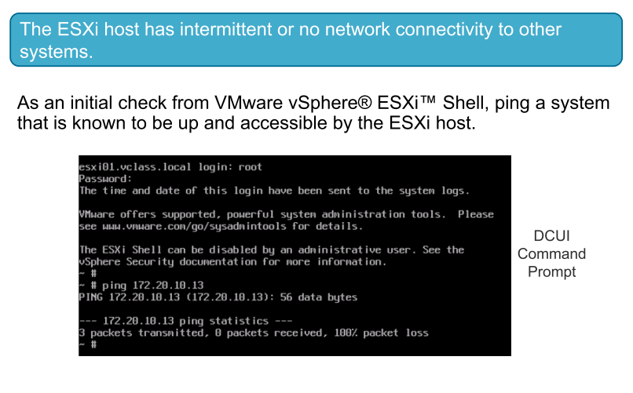
Network Problem 1

Slide 8
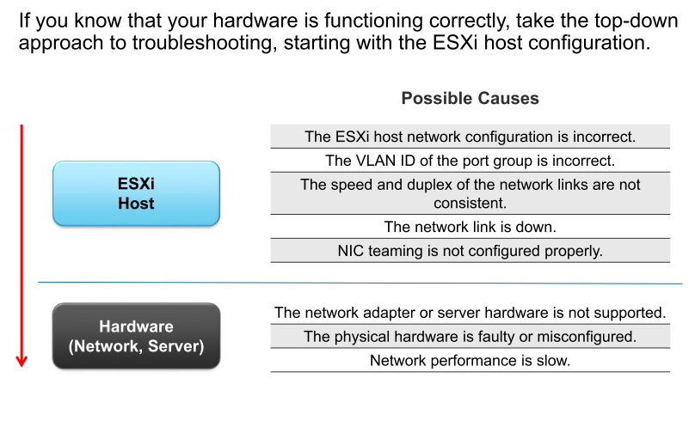
Identifying Possible Causes

Slide 9
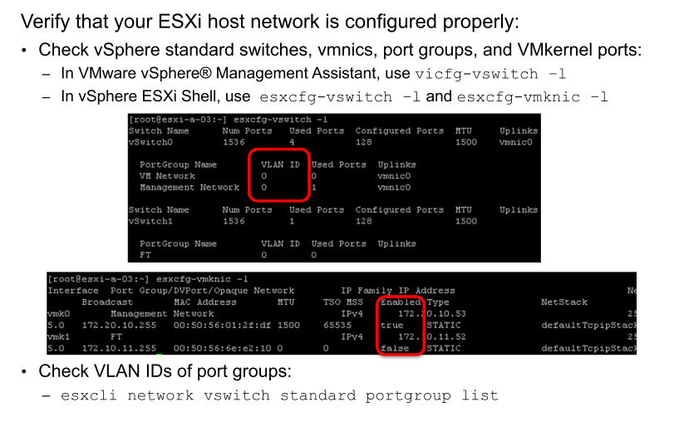
Possible Cause: ESXi Network Misconfiguration (1)

Slide 10
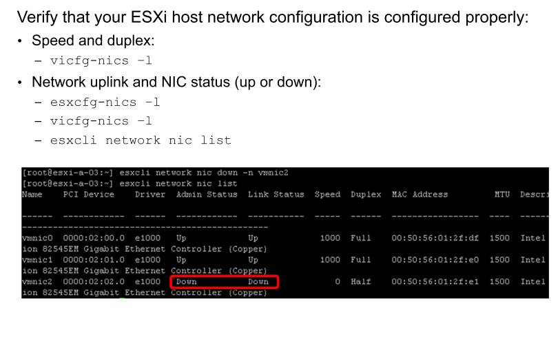
Possible Cause: ESXi Network Misconfiguration (2)
Notes:
From vSphere Management Assistant, use the vicfg-nics command to check the network adapter’s speed and duplex as well as the link status.
The command output in the slide demonstrates a vmnic that is manually brought down by the esxcli network nic down –n command. You can manually bring the vmnic up. For example, to bring up the vmnic2, use the esxcli network nic up –n vmnic2 command.

Slide 11
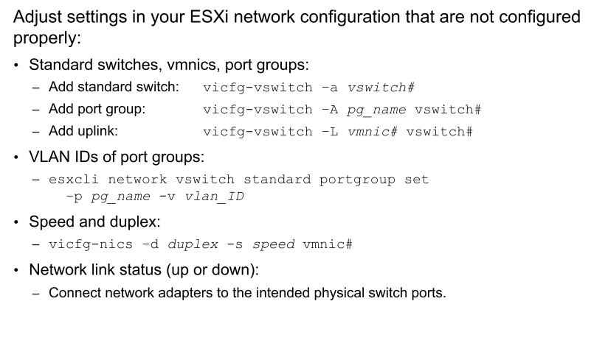
Resolving ESXi Network Misconfiguration

Slide 12
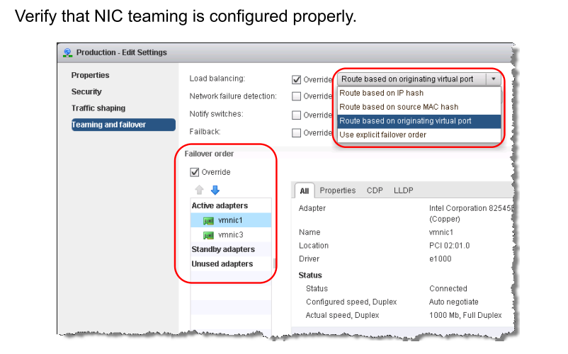
Possible Cause: NIC Teaming Misconfiguration

Slide 13
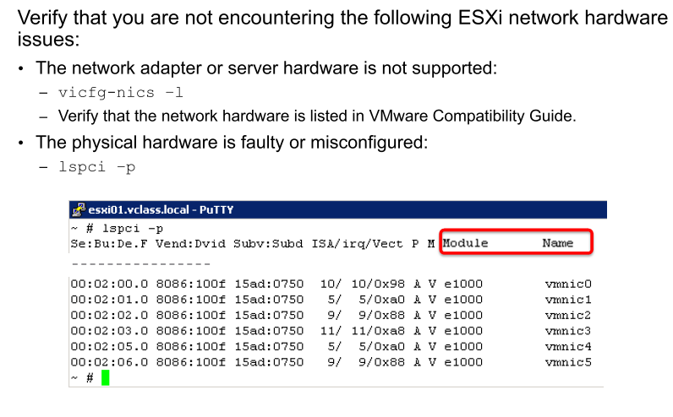
Possible Cause: Unsupported or Faulty Hardware

Slide 14
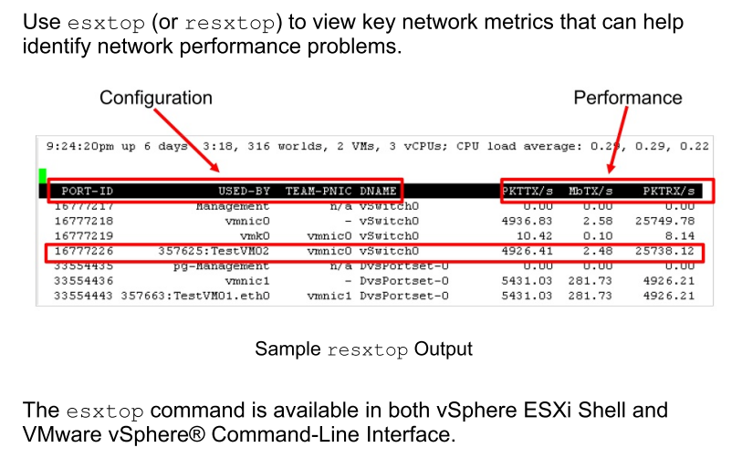
Possible Cause: Slow Network Performance

Slide 15
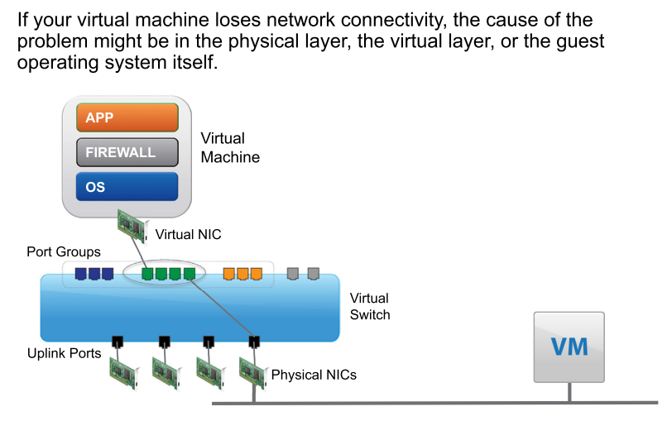
Review of Virtual Machine Connectivity

Slide 16
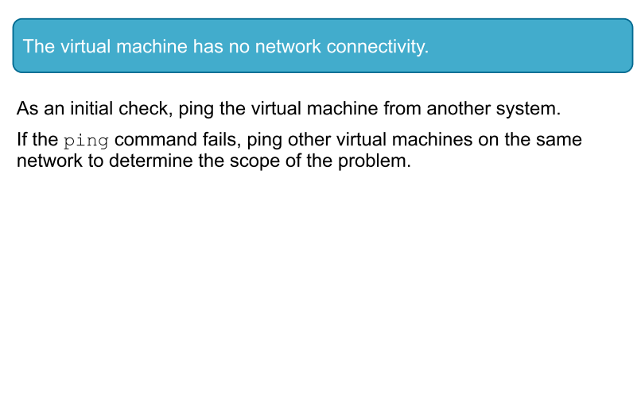
Network Problem 2

Slide 17
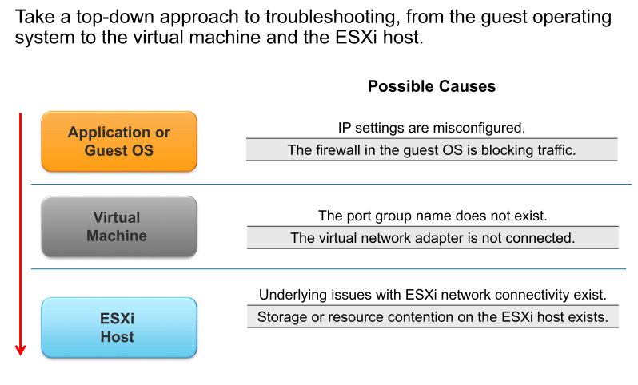
Identifying Possible Causes

Slide 18
Possible Cause: IP Settings and Firewall Problems
IP settings and problems with firewalls might cause the problem.
Check IP settings to ensure that the TCP/IP settings in the guest operating system are correct.
The firewall in the guest operating system might be blocking traffic. Ensure that the firewall does not block required ports.

Slide 19
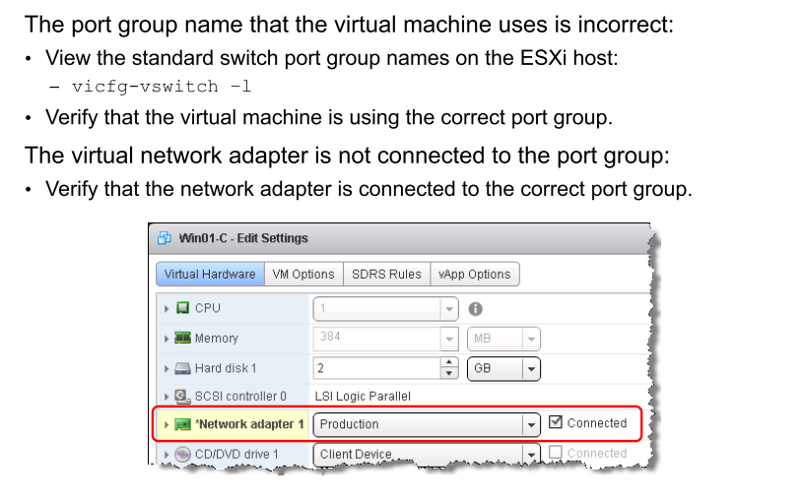
Possible Cause: Port Group Misconfiguration

Slide 20
Possible Cause: ESXi Network Connectivity Problems
Storage or resource contention on the ESXi host can cause network connectivity issues:
Ensure that the virtual machine has no underlying issues with storage and that it is not in resource contention.
Problems might exist with the ESXi host network, the port group ID, the speed or duplex settings, the physical network link, or the NIC teaming configuration.
To eliminate a NIC failure or physical configuration issue, connect the virtual machine to a virtual switch that uses NIC teaming.

Slide 21
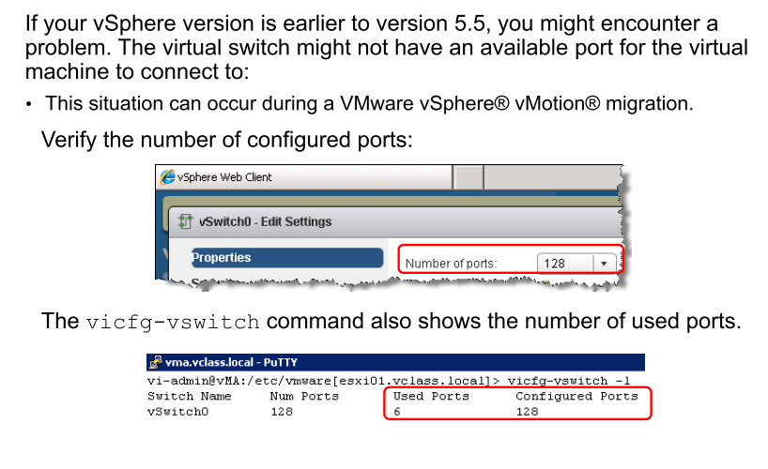
Possible Cause: No Available Ports on Virtual Switch

Slide 22
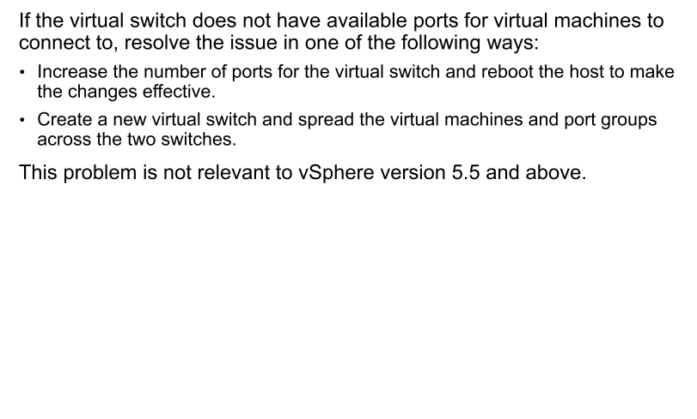
Resolving the Issue of Unavailable Ports on a Virtual Switch

Slide 23
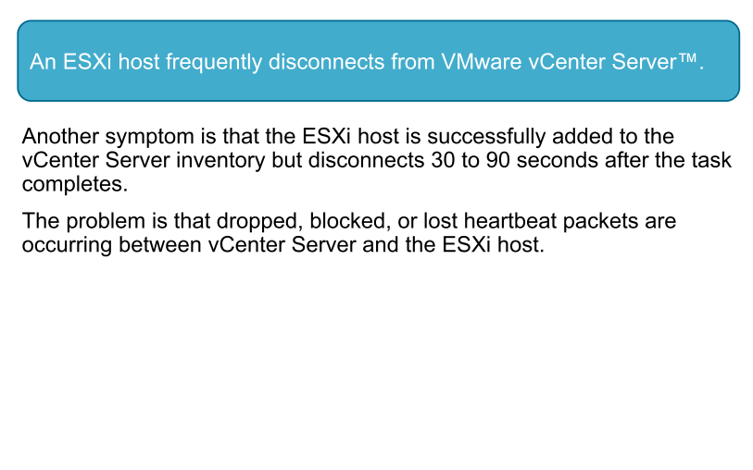
Network Problem 3

Slide 24
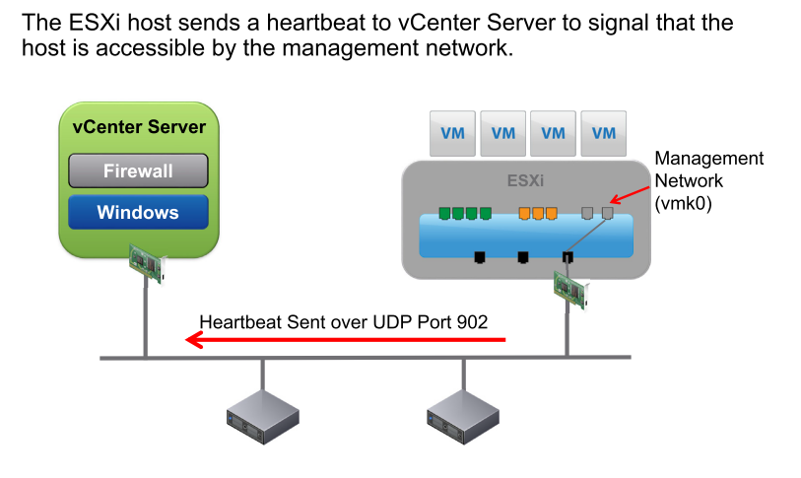
Heartbeat Communication Between vCenter Server and ESXi

Slide 25
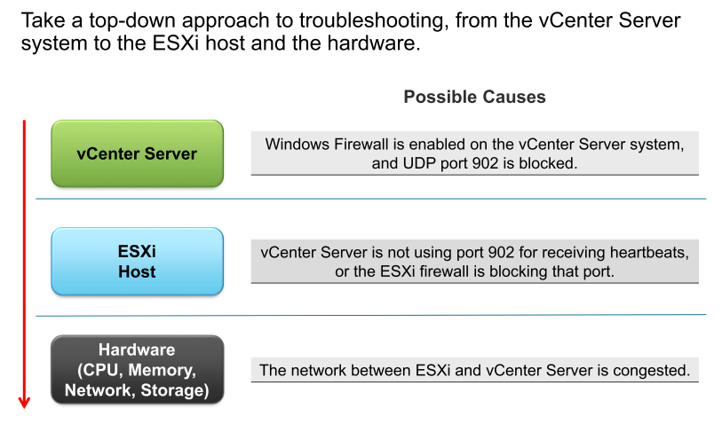
Identifying Possible Causes

Slide 26
Possible Cause: Port Blocked by Windows Firewall
If Windows Firewall is enabled and UDP port 902 is blocked, view the ports blocked by Windows Firewall.
To resolve this problem, adjust Windows Firewall settings:
If ports are not configured, disable Windows Firewall.
If the firewall is configured to affect ports, ensure that Windows Firewall is not blocking UDP port 902.

Slide 27
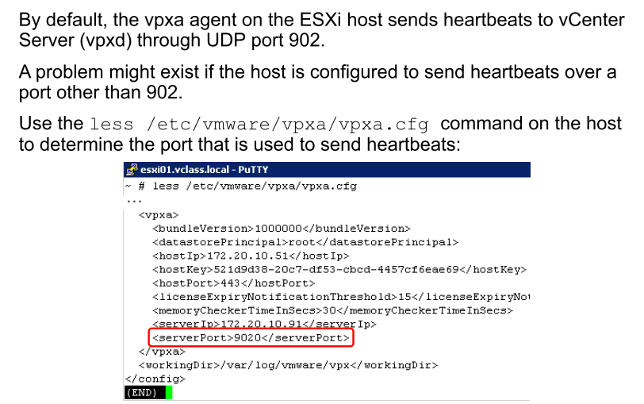
Possible Cause: vCenter Server Not Using Port 902

Slide 28
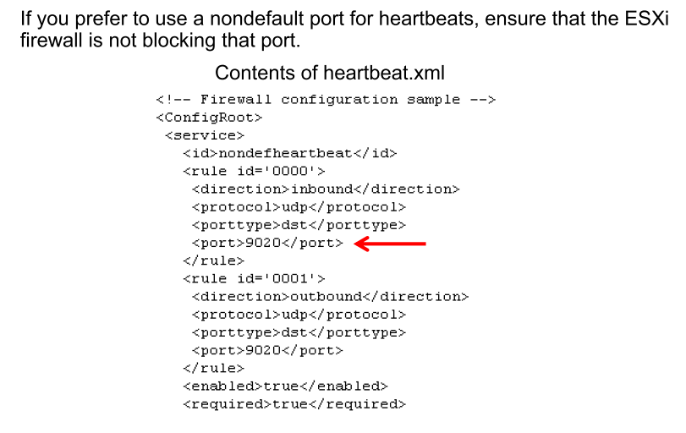
Resolving the Use of a Port Other Than 902 (1)

Slide 29
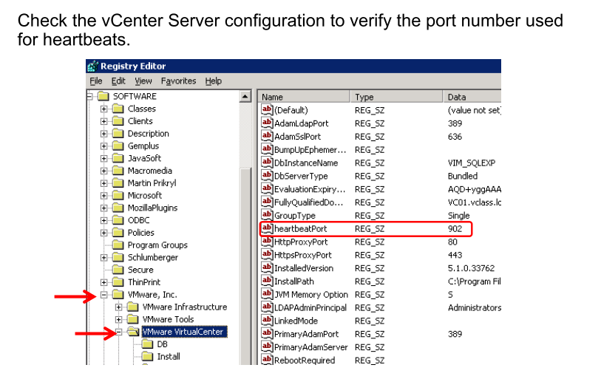
Resolving the Use of a Port Other Than 902 (2)

Slide 30
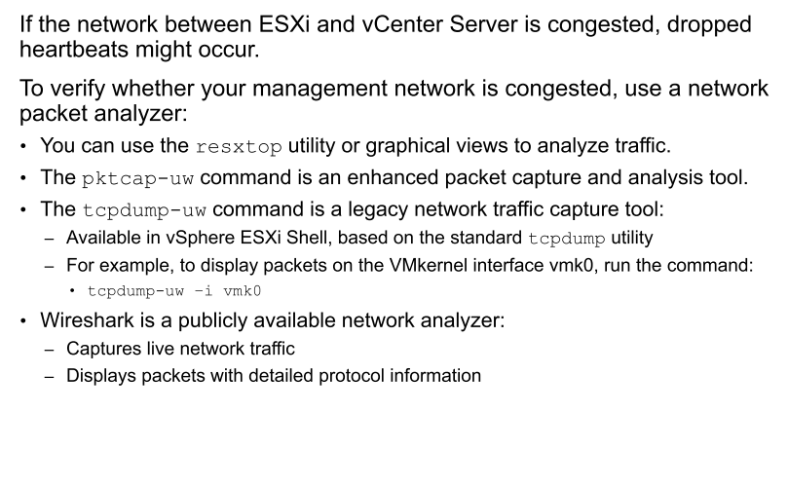
Possible Cause: Network Congestion

Slide 31
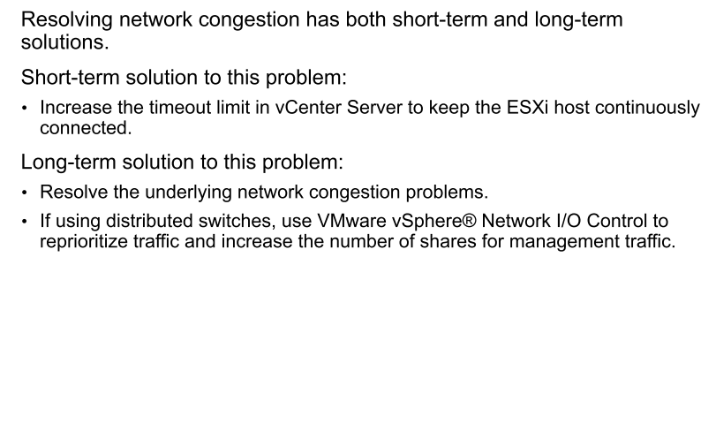
Resolving Network Congestion

Slide 32
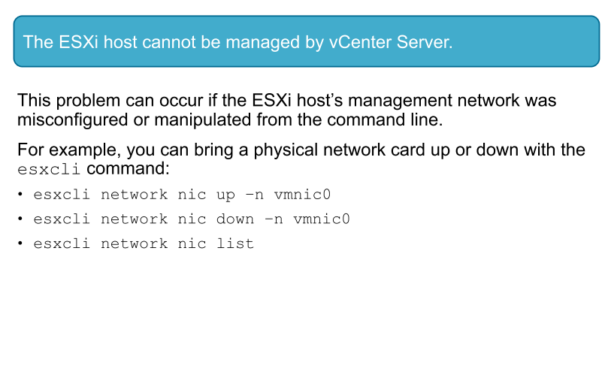
Network Problem 4

Slide 33
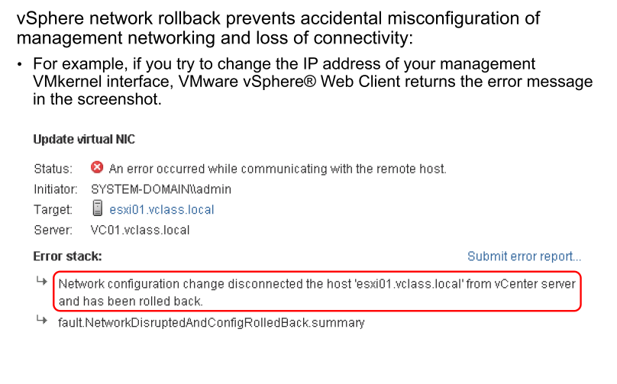
Preventing Loss of Management Network Connectivity

Slide 34
Host Networking Rollback
Rollback enables you to roll back to a previous valid configuration.
The host networking rollback is triggered when a network configuration change is made that disconnects the host.
Several events can trigger a host networking rollback:
Updating DNS and routing settings
Updating the speed or duplex of a physical NIC
Changing the IP settings of a management VMkernel network adapter
Updating teaming and failover policies to a port group that contains the management VMkernel network adapter
If a network disconnects for any of these reasons, the task fails and the host reverts to the last valid configuration.

Slide 35
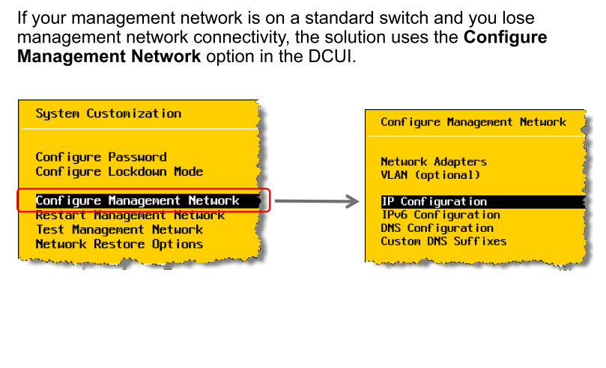
Recovering a Lost Management Network: Standard Switch

Slide 36
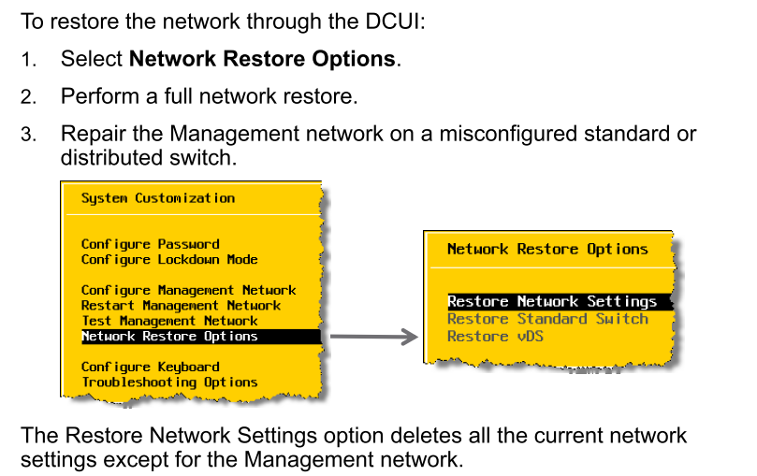
Network Restore Options in the DCUI

Slide 37
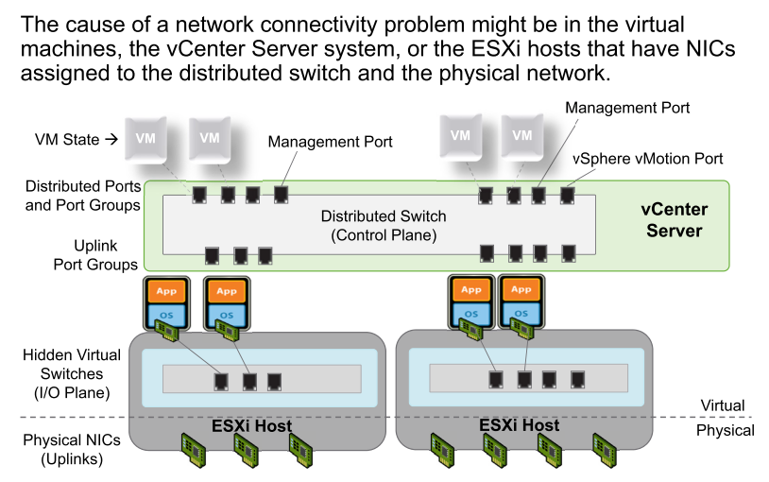
Review of Distributed Switch Network Connectivity

Slide 38
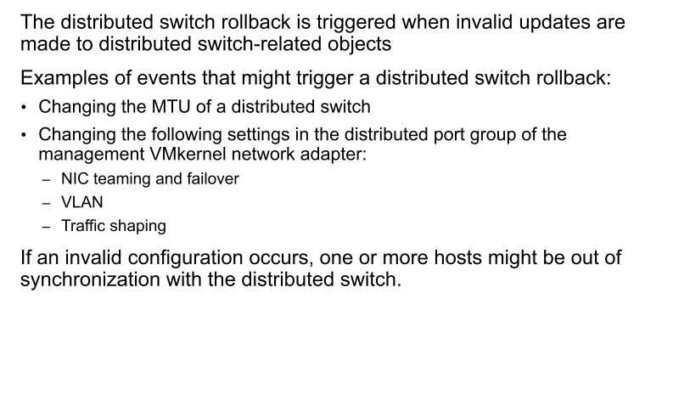
Distributed Switch Rollback

Slide 39
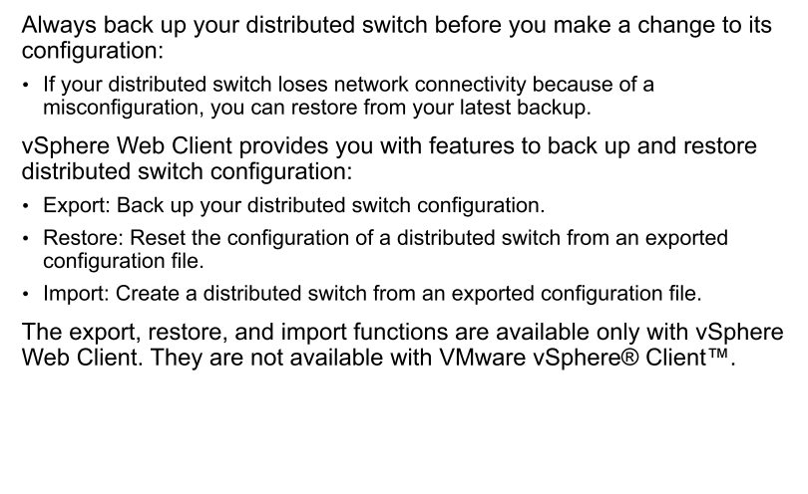
Recovering from a Distributed Switch Misconfiguration

Slide 40
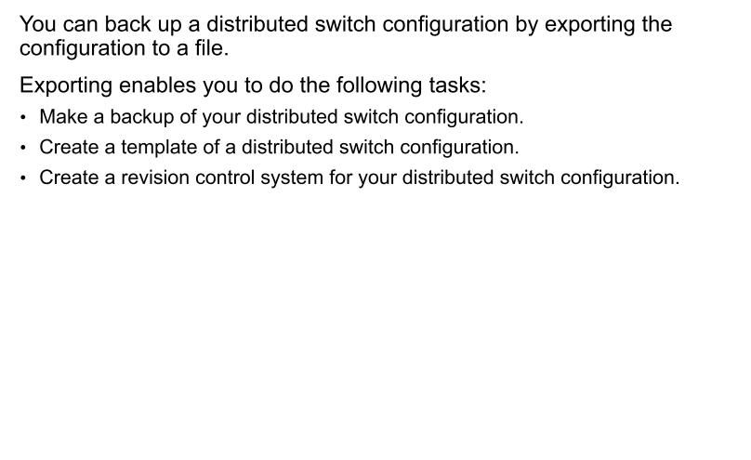
Backing Up a Distributed Switch Configuration

Slide 41
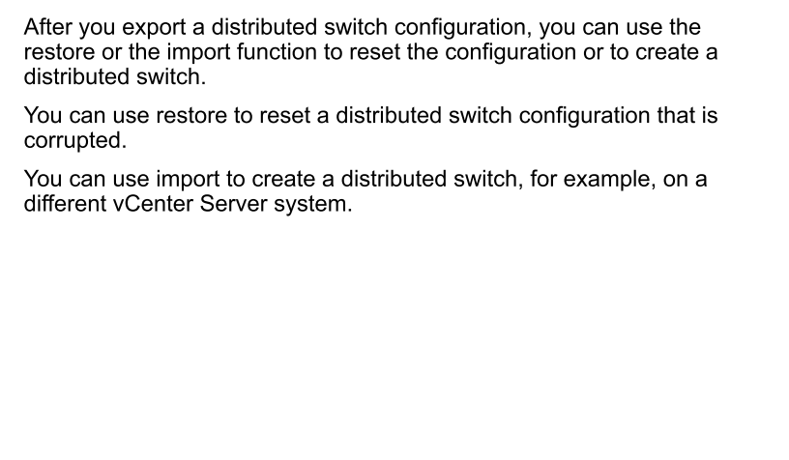
Restoring and Importing a Distributed Switch Configuration

Slide 42
Review of Learner Objectives
You should be able to meet the following objectives:
Provide a network troubleshooting overview
Analyze and troubleshoot standard switch problems
Analyze and troubleshoot virtual machine connectivity problems
Analyze and troubleshoot management network problems
Analyze and troubleshoot distributed switch problems

